Slide 1
MEDIK
REQUIREMENT, DESIGN AND TESTING FOR TELEMEDCINE APP
COURSE INSTRUCTOR: DR. TSAGUE ALINE

Slide 2
INTRODUCTION
Telemedicine applications, also known as telehealth apps, have emerged as transformative tools in the healthcare landscape. With the growing need for medical attention without any latency, mobility issues and other challenges hindering the offering of quick medical services at maximum comfort, medical services through telecommunication are at high need. These mobile applications enable individuals to access healthcare services remotely, bridging geographical distances and overcoming mobility challenges. By leveraging the power of smartphones and other digital devices, telemedicine applications are revolutionizing the way healthcare is delivered and consumed .
The application's core functionalities include:
Real-time video and audio consultations
Secure messaging
Online prescription generation
Pharmacy services
Appointment scheduling

Slide 3
PROJECT DETAILS, REQUIREMENT DESCRIPTION AND STANDARDS ANALYSIS
FUNCTIONAL REQUIREMENTS:
➢ User Authentication and Security of User Data:
➢ Patient-Healthcare Provider Communication and Consultation
➢ Payment Processing and Transactions
➢ Appointment Scheduling and Management
➢ Medical Records Management
➢ Prescription Services
NON-FUNCTIONAL REQUIREMENTS:
➢ Security of telemedicine application
➢ Usability and User Experience
➢ Reliability and Availability
➢ Accessibility
➢ Performance and Scalability

Slide 4
ANALYSIS AND RESEARCH ILLUSTRATION FOR MEDIK
> OVERVIEW
> ANALYSIS
> RESEARCH
> ILLUSTRATION

Slide 5
ARCHITECTURAL REQUIREMENTS
Stakeholders
MEDIK will basically involve four major stakeholders i.e., the patient, healthcare center (which will consist of health experts), pharmacy and administrator.
Layers
MEDIK consists of 3 main layers or tiers namely
The Presentation layer also commonly known as the frontend or user interface using React native due to its light weight and cross platform nature.
The Application layer also commonly known as the logic tier or middle tier which will be done using TypeScript due to its assured security and high-performance in integration with React native.
The Data layer which will involve manipulation of data in the database which will be done using MongoDB due to its role-based access control features as well as security features like authentication, authorization, and transparent data encryption (which automatically encrypt data at rest in database).

Slide 6
ARCHITECTURAL REQUIREMENTS
User Interfaces (Clients)
Patient App: A mobile or web app that allows patients to register, sign in, manage their profiles, schedule appointments, and communicate with healthcare providers in real-time.
Healthcare Provider App: A web app used by doctors and other healthcare providers to manage appointments, access patient records, and conduct virtual consultations.
Admin Panel: A web-based interface for system administrators to manage the platform, users, and data.
Communication Components
Video/Audio Streaming: Real-time communication channels for virtual consultations.
Chat Messaging: Text-based communication for quick queries and follow-ups.
APIs and Logic
Authentication and Authorization: Secure methods for user registration and access control.
Appointment Management: Functionality to schedule, modify, or cancel appointments.
Medical Record Management: Secure storage and retrieval of patient medical records.
Medically Trained Expert System Model API: for Expert System consultations and user guide through system’s user interface.

Slide 7
ARCHITECTURAL REQUIREMENTS
Storage and Infrastructure Services
Database: A secure database to store user data, medical records, appointment details, and other relevant information.
File Storage: For storing and sharing documents, images, and other files.
Payment Gateway: To process financial transactions for services rendered.
Security Measures
Data Encryption: To protect sensitive data during transmission and at rest.
Compliance: Adherence to healthcare regulations like HIPAA for patient data privacy.
Access Logs and Monitoring: To track usage and detect any unauthorized access.
Integration with External Systems
Pharmacy Systems: For sending prescriptions and managing medication orders.
Network Architecture
Cloud-based architecture will be used precisely Azure where computations will be done over the internet (or the cloud). Azure was chosen due to its high security, high performance (since computing will be independent on the specifications of the user’s device) and its scalability.

Slide 8
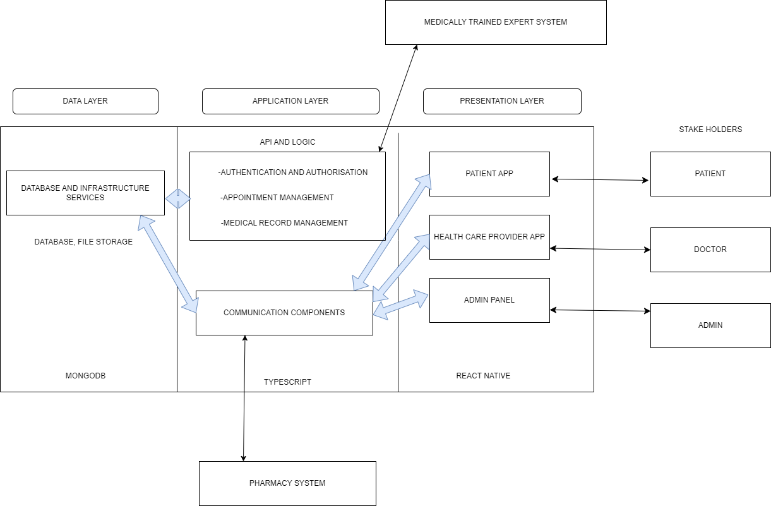
ARCHITECTURAL DESIGN

Slide 9
INTERNATIONAL QUALITY STANDARDS FOR TELEMEDICINE APPS
Health Insurance Portability and Accountability Act(HIPAA)
General Data Protection Regulation (GDPR)
International Organization for Standardization (ISO) 27001
Digital Imaging and Communications in Medicine (DICOM):

Slide 10
SOFTWARE QUALITY MODEL FOR MEDIK TELEMEDICINE APP
1) AdEQUATE Model
2) ISO/IEC 25010 Quality Model
> Functionality
> Reliability
> Usability
> Efficiency:
> Maintainability
> Portability
> Security
> Testability

Slide 11
SYSTEM, USER INTERFACE (UI) AND DATABASE DESIGN OF MEDIK 1) SYSTEM DESIGN

Slide 12
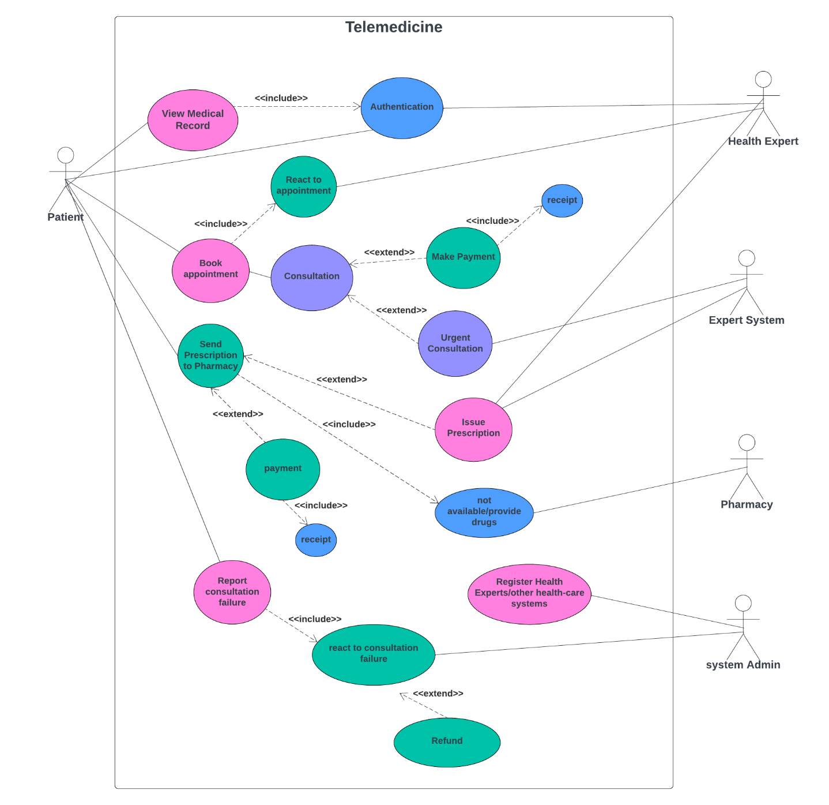
USECASE DIAGRAM

Slide 13
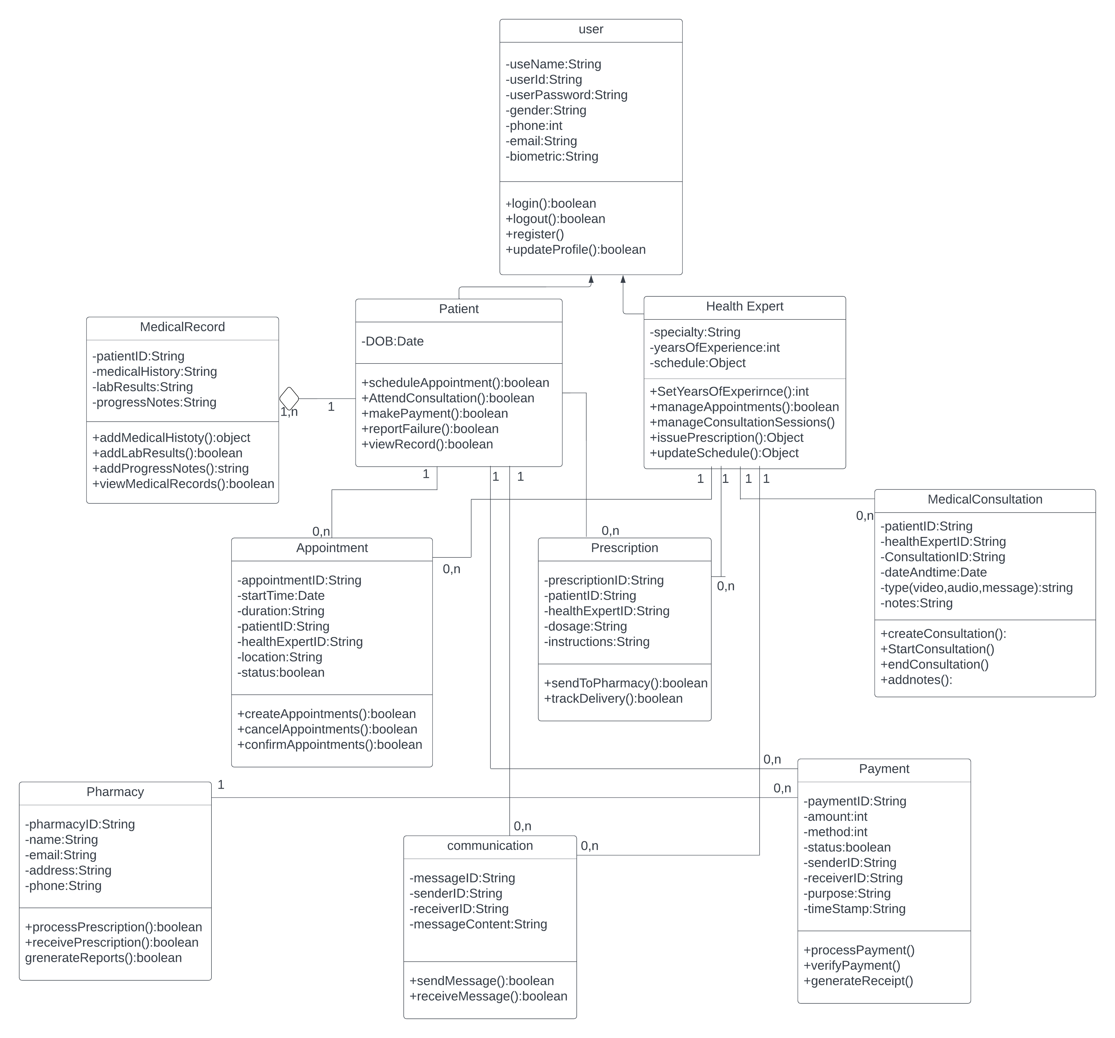
CLASS DIAGRAM

Slide 14
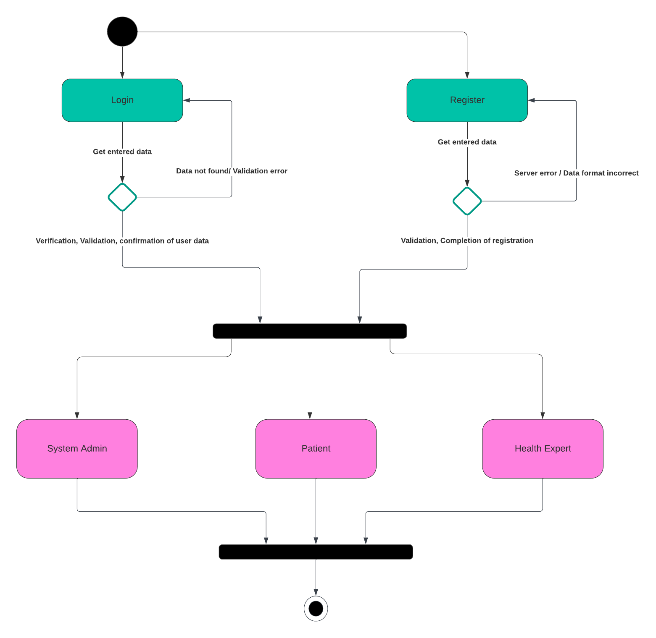
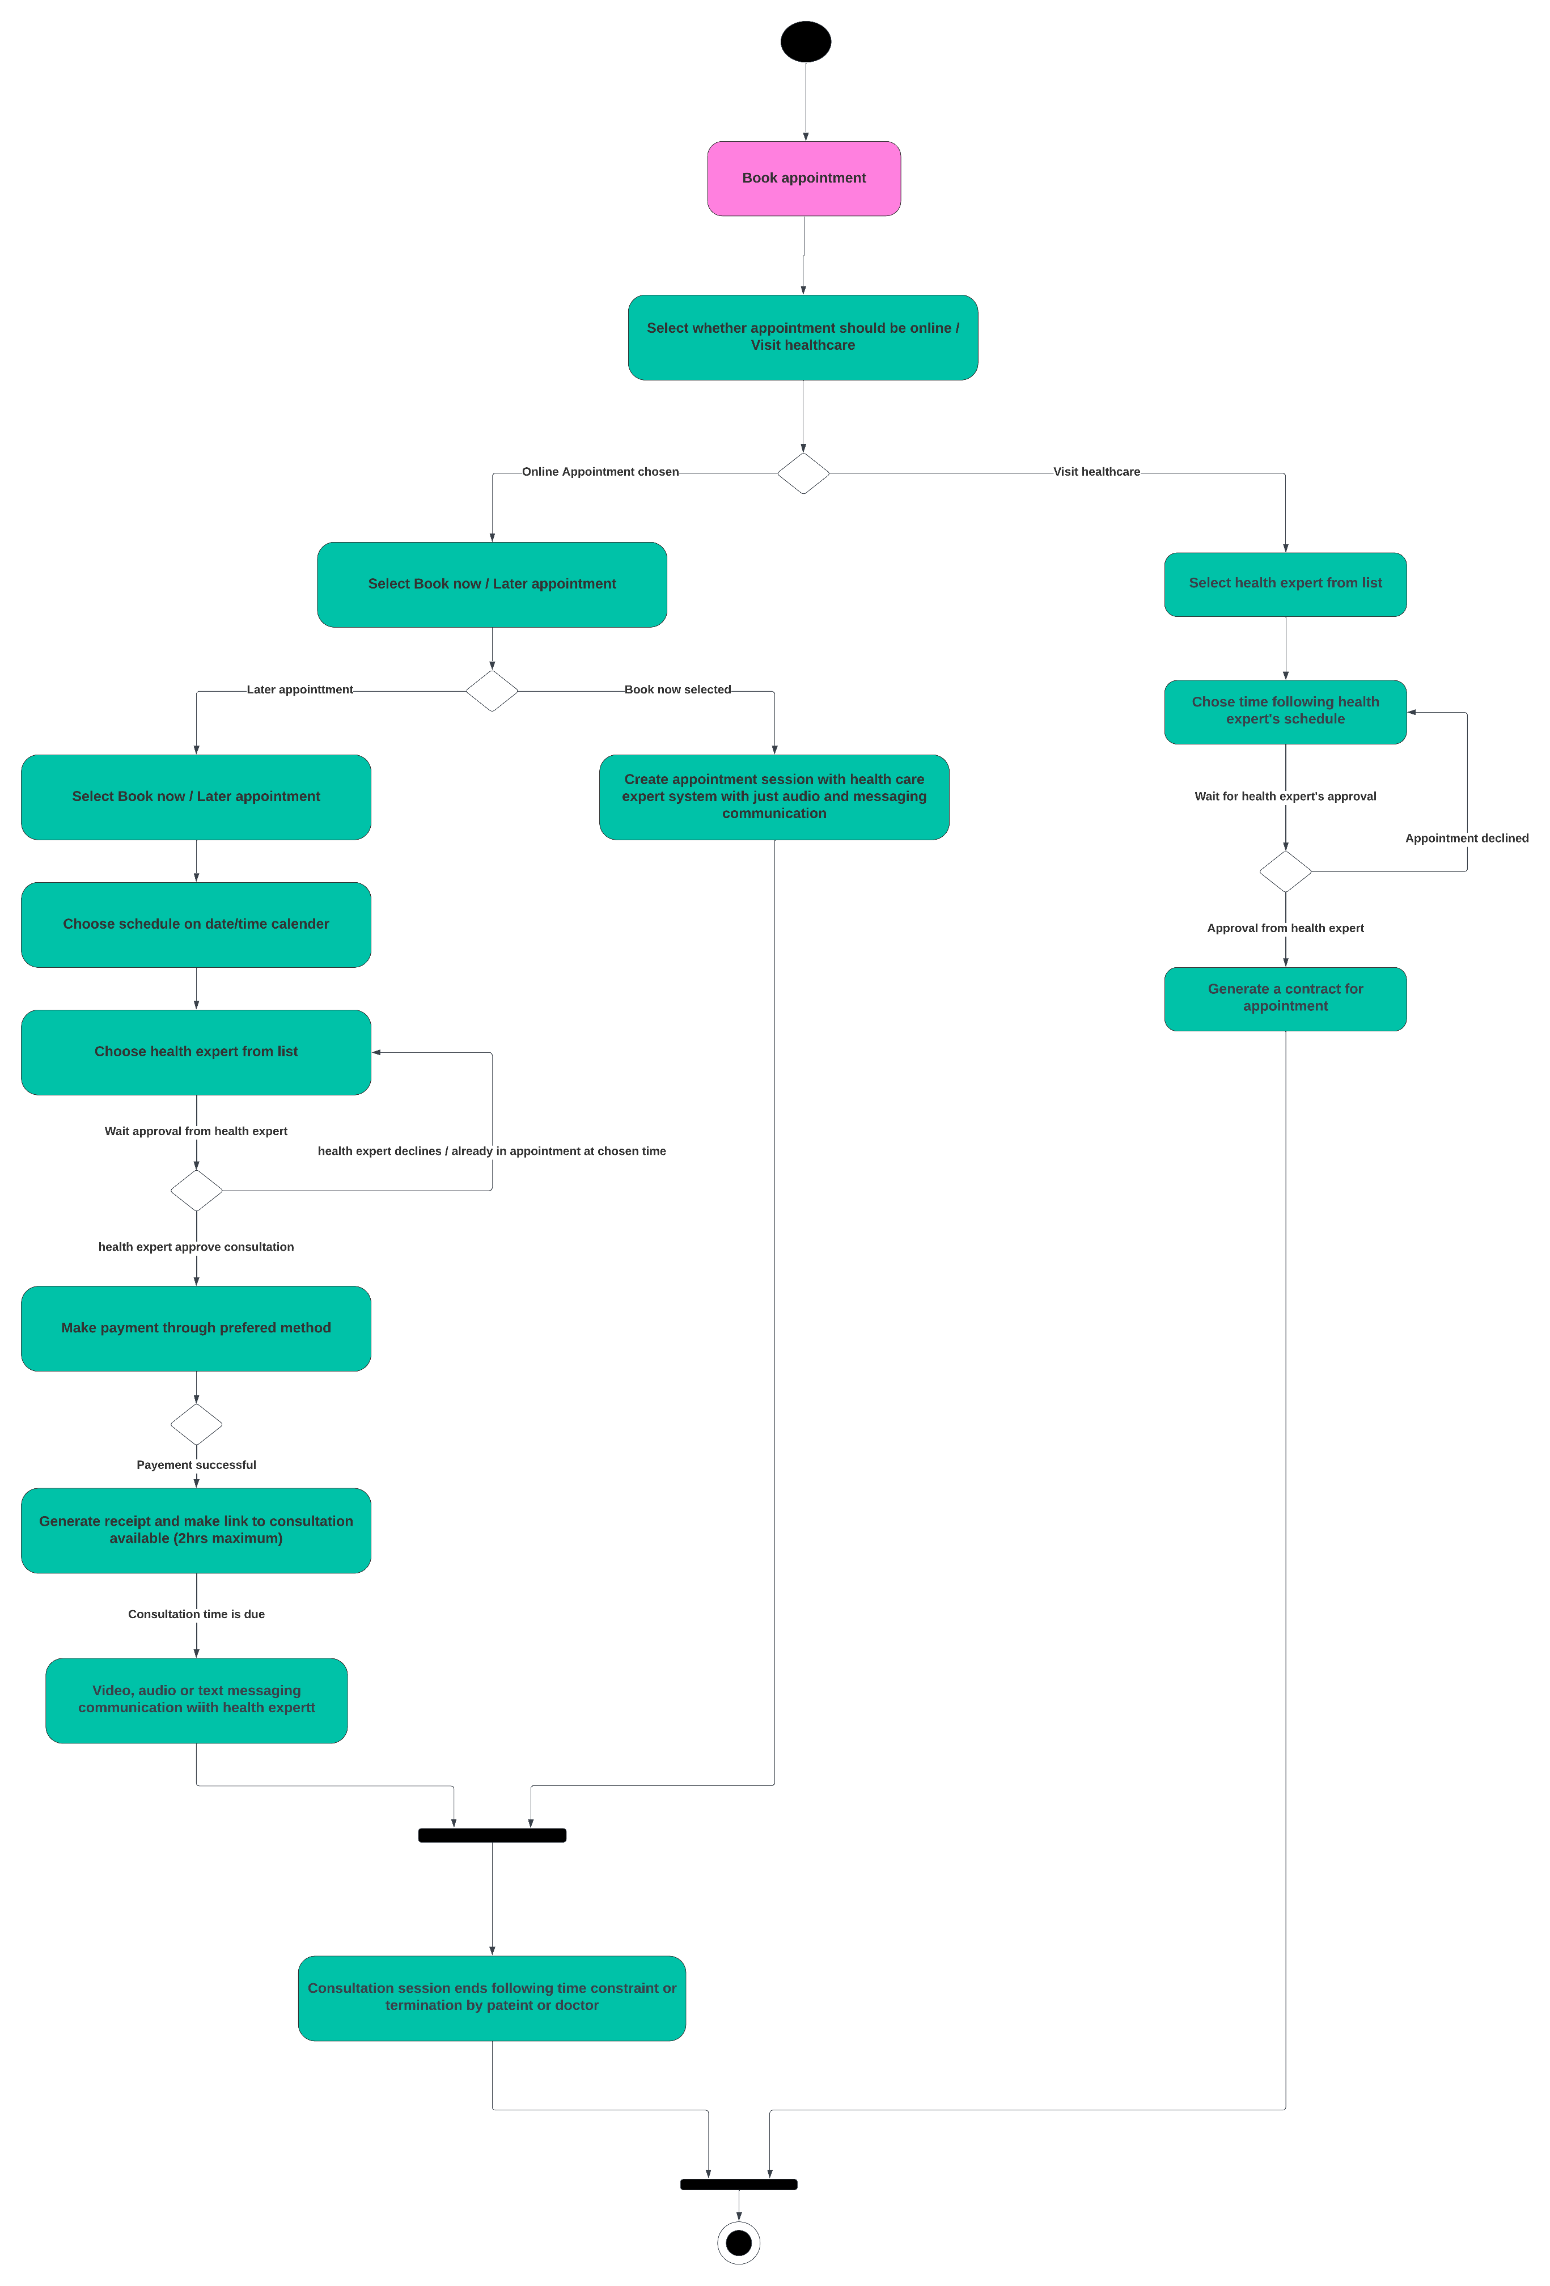
ACTIVITY DIAGRAM FOR LOGIN AND BOOKING APPOINTMENTS

Slide 15
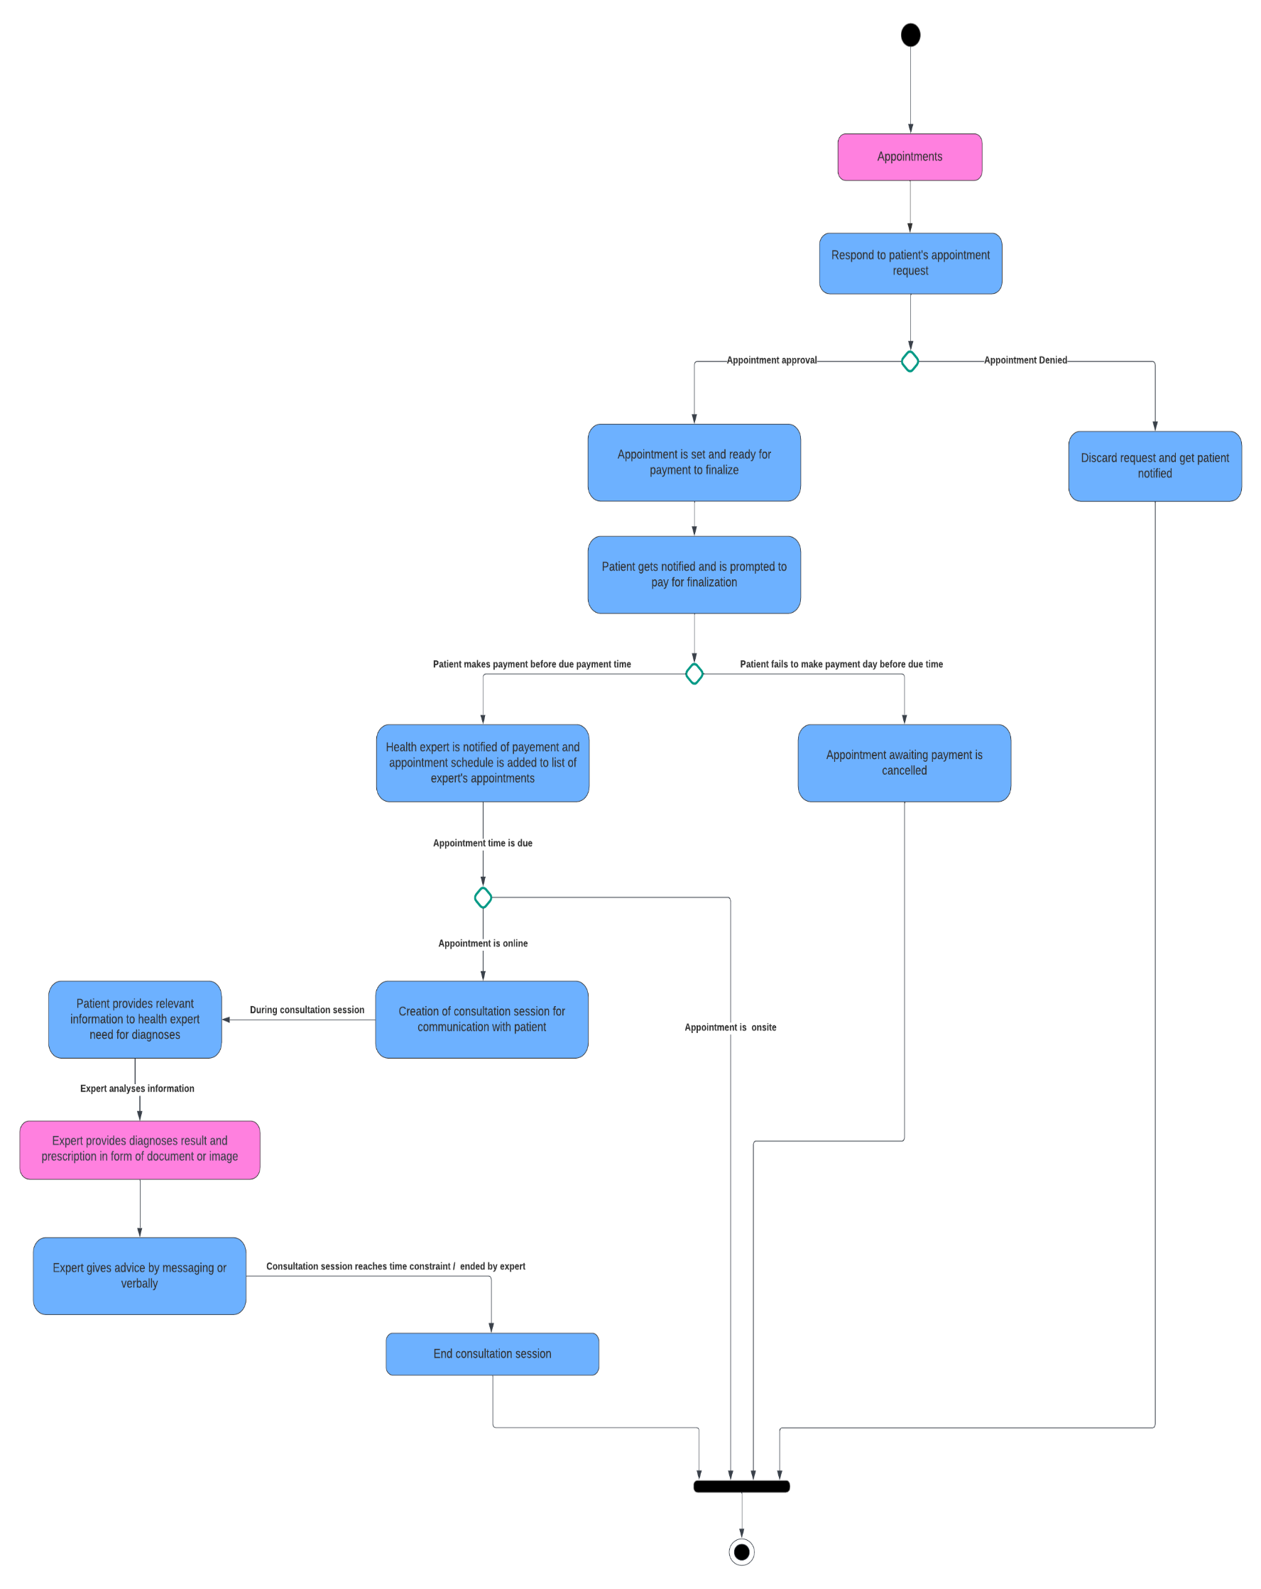
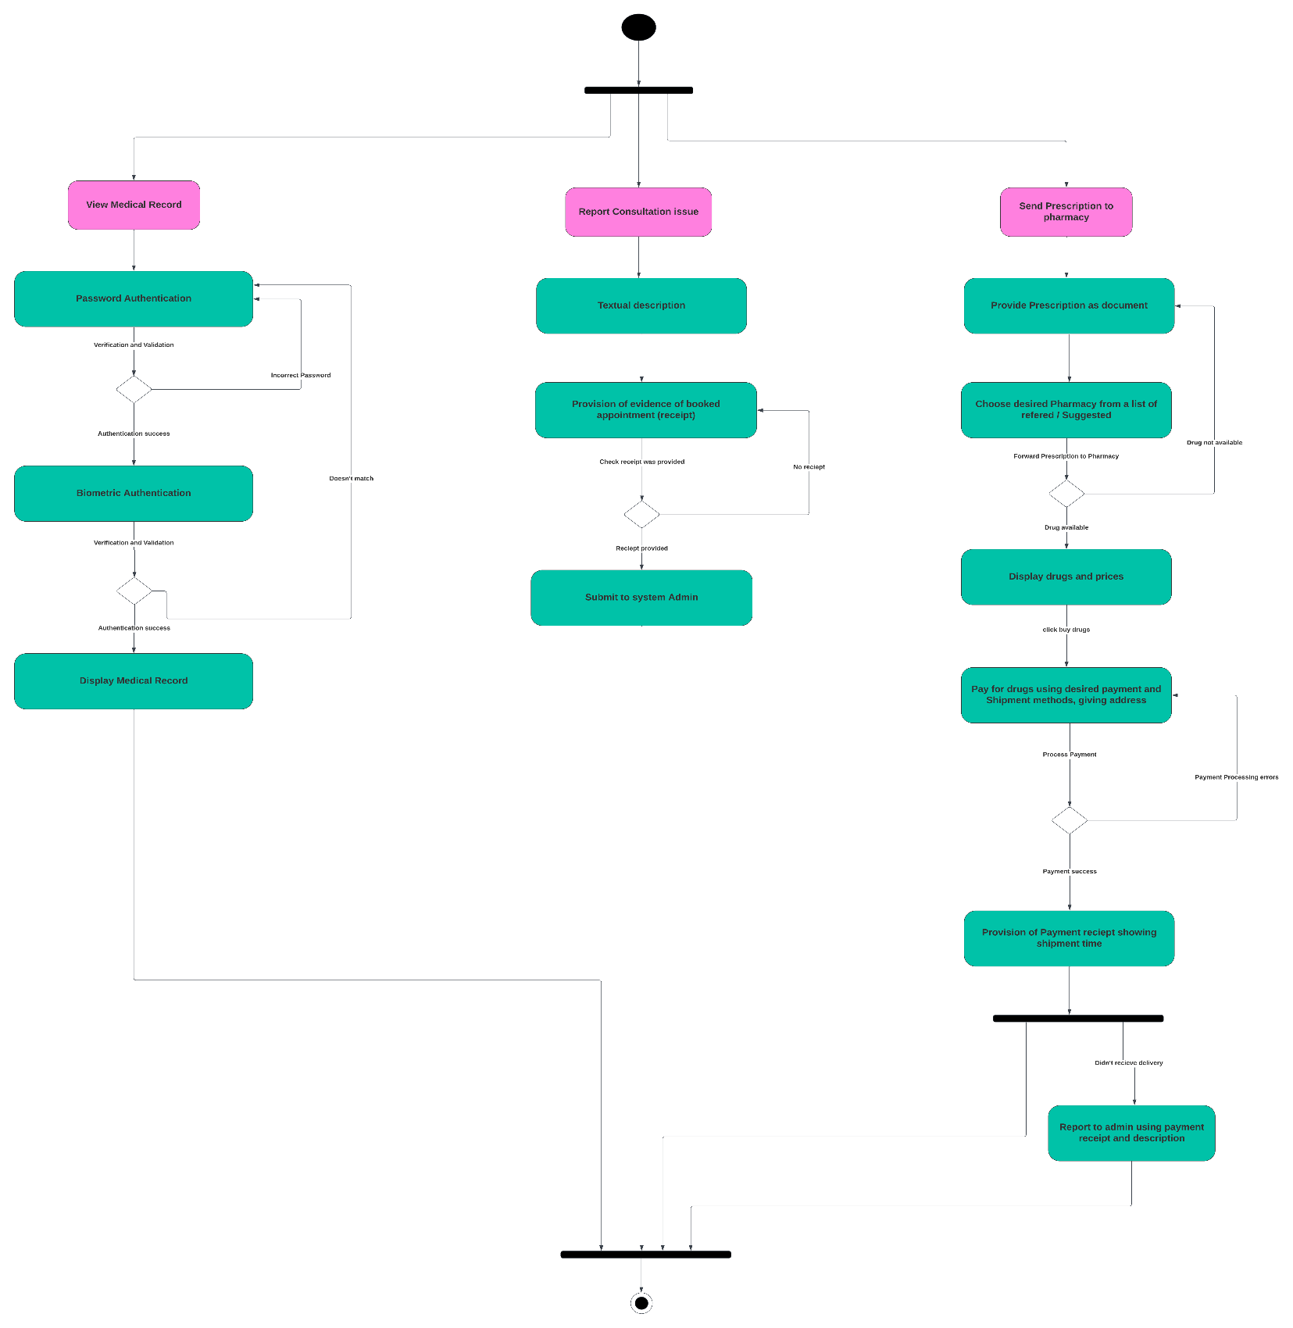
ACTIVITY DIAGRAM FOR PATIENT ACTIVITIES

Slide 16
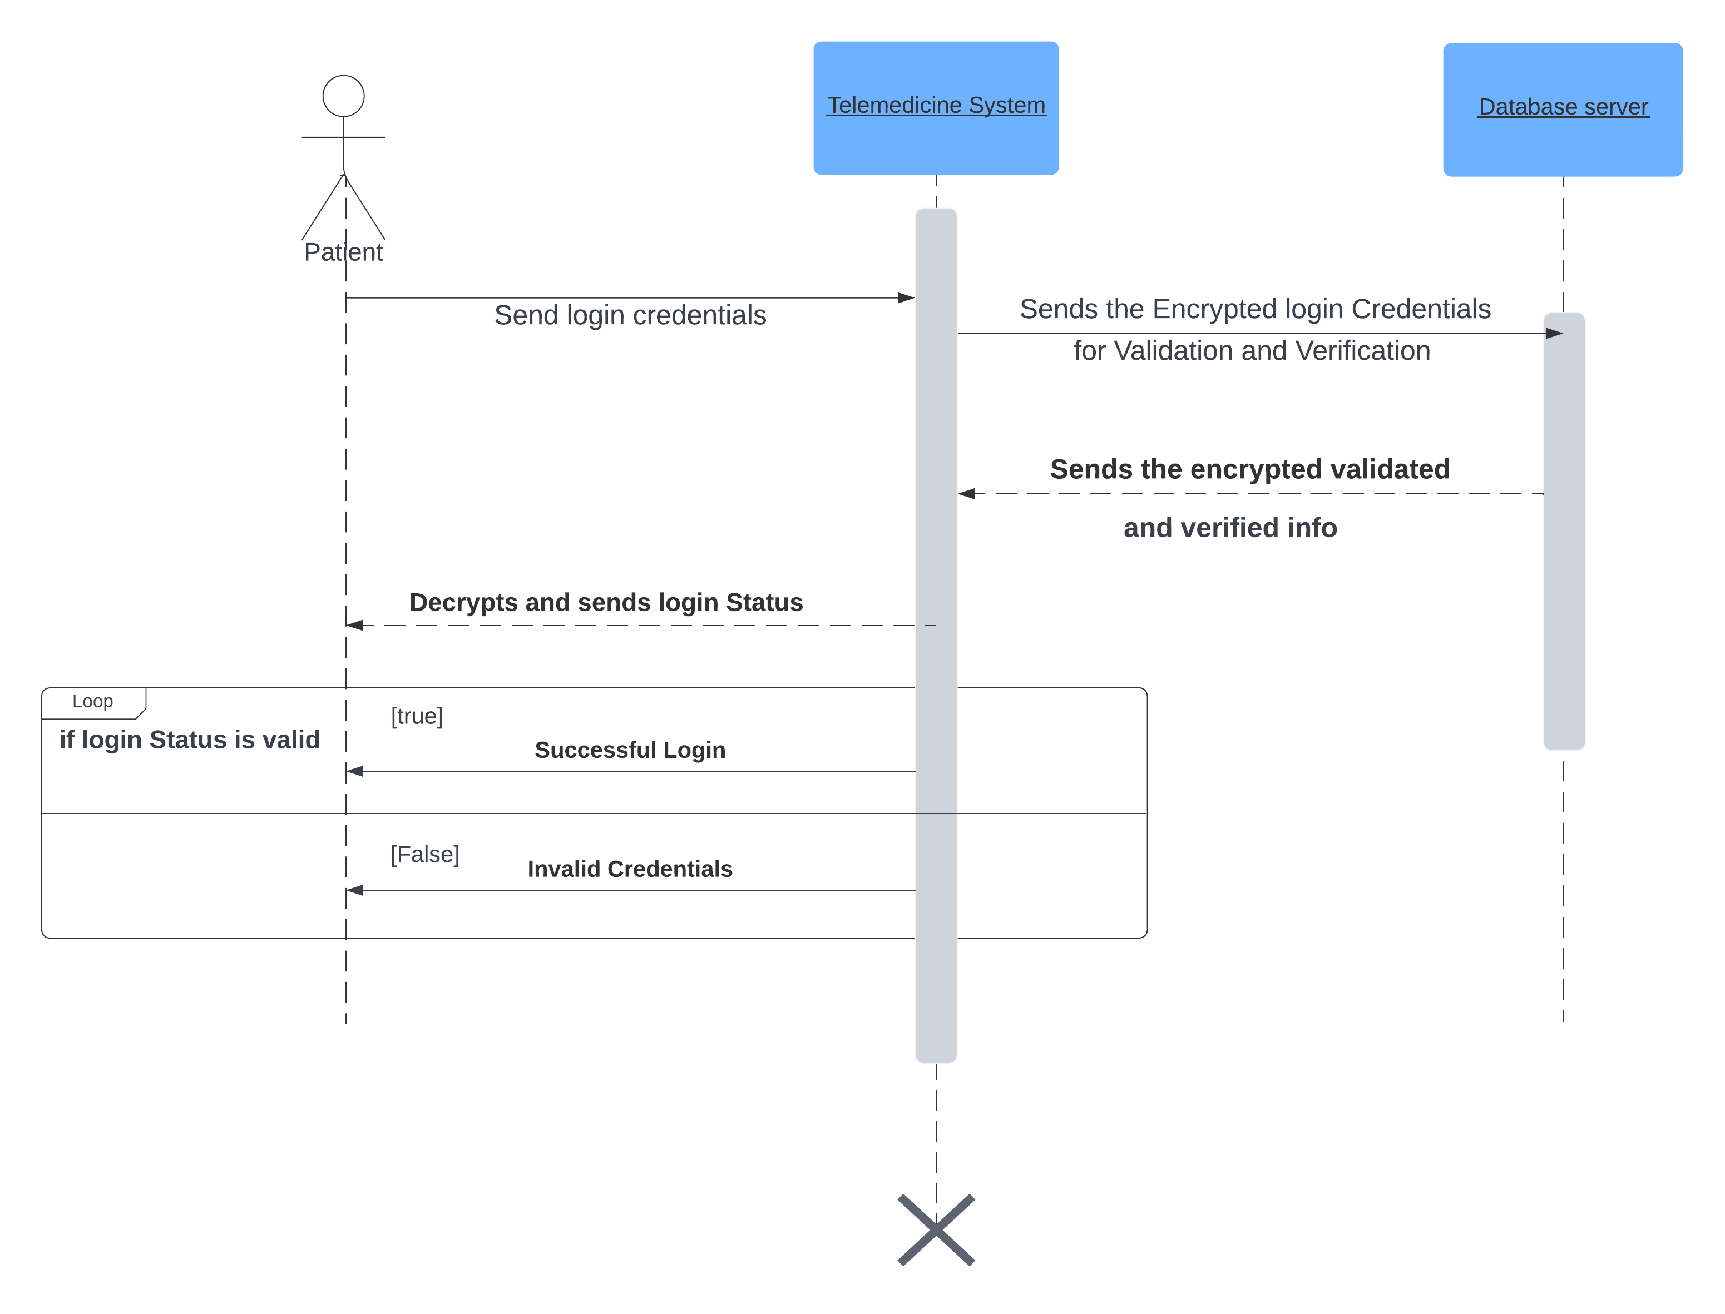
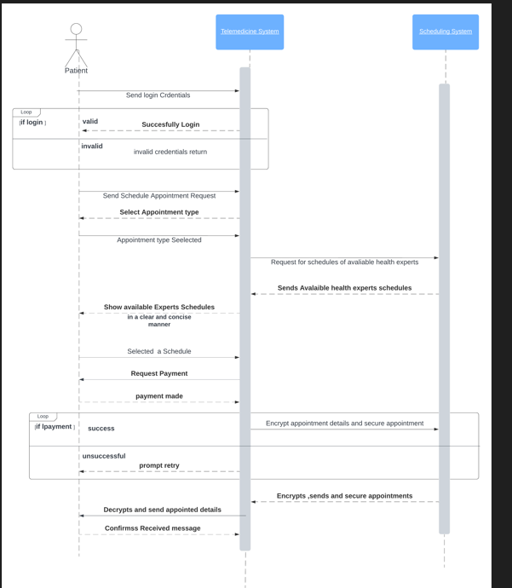
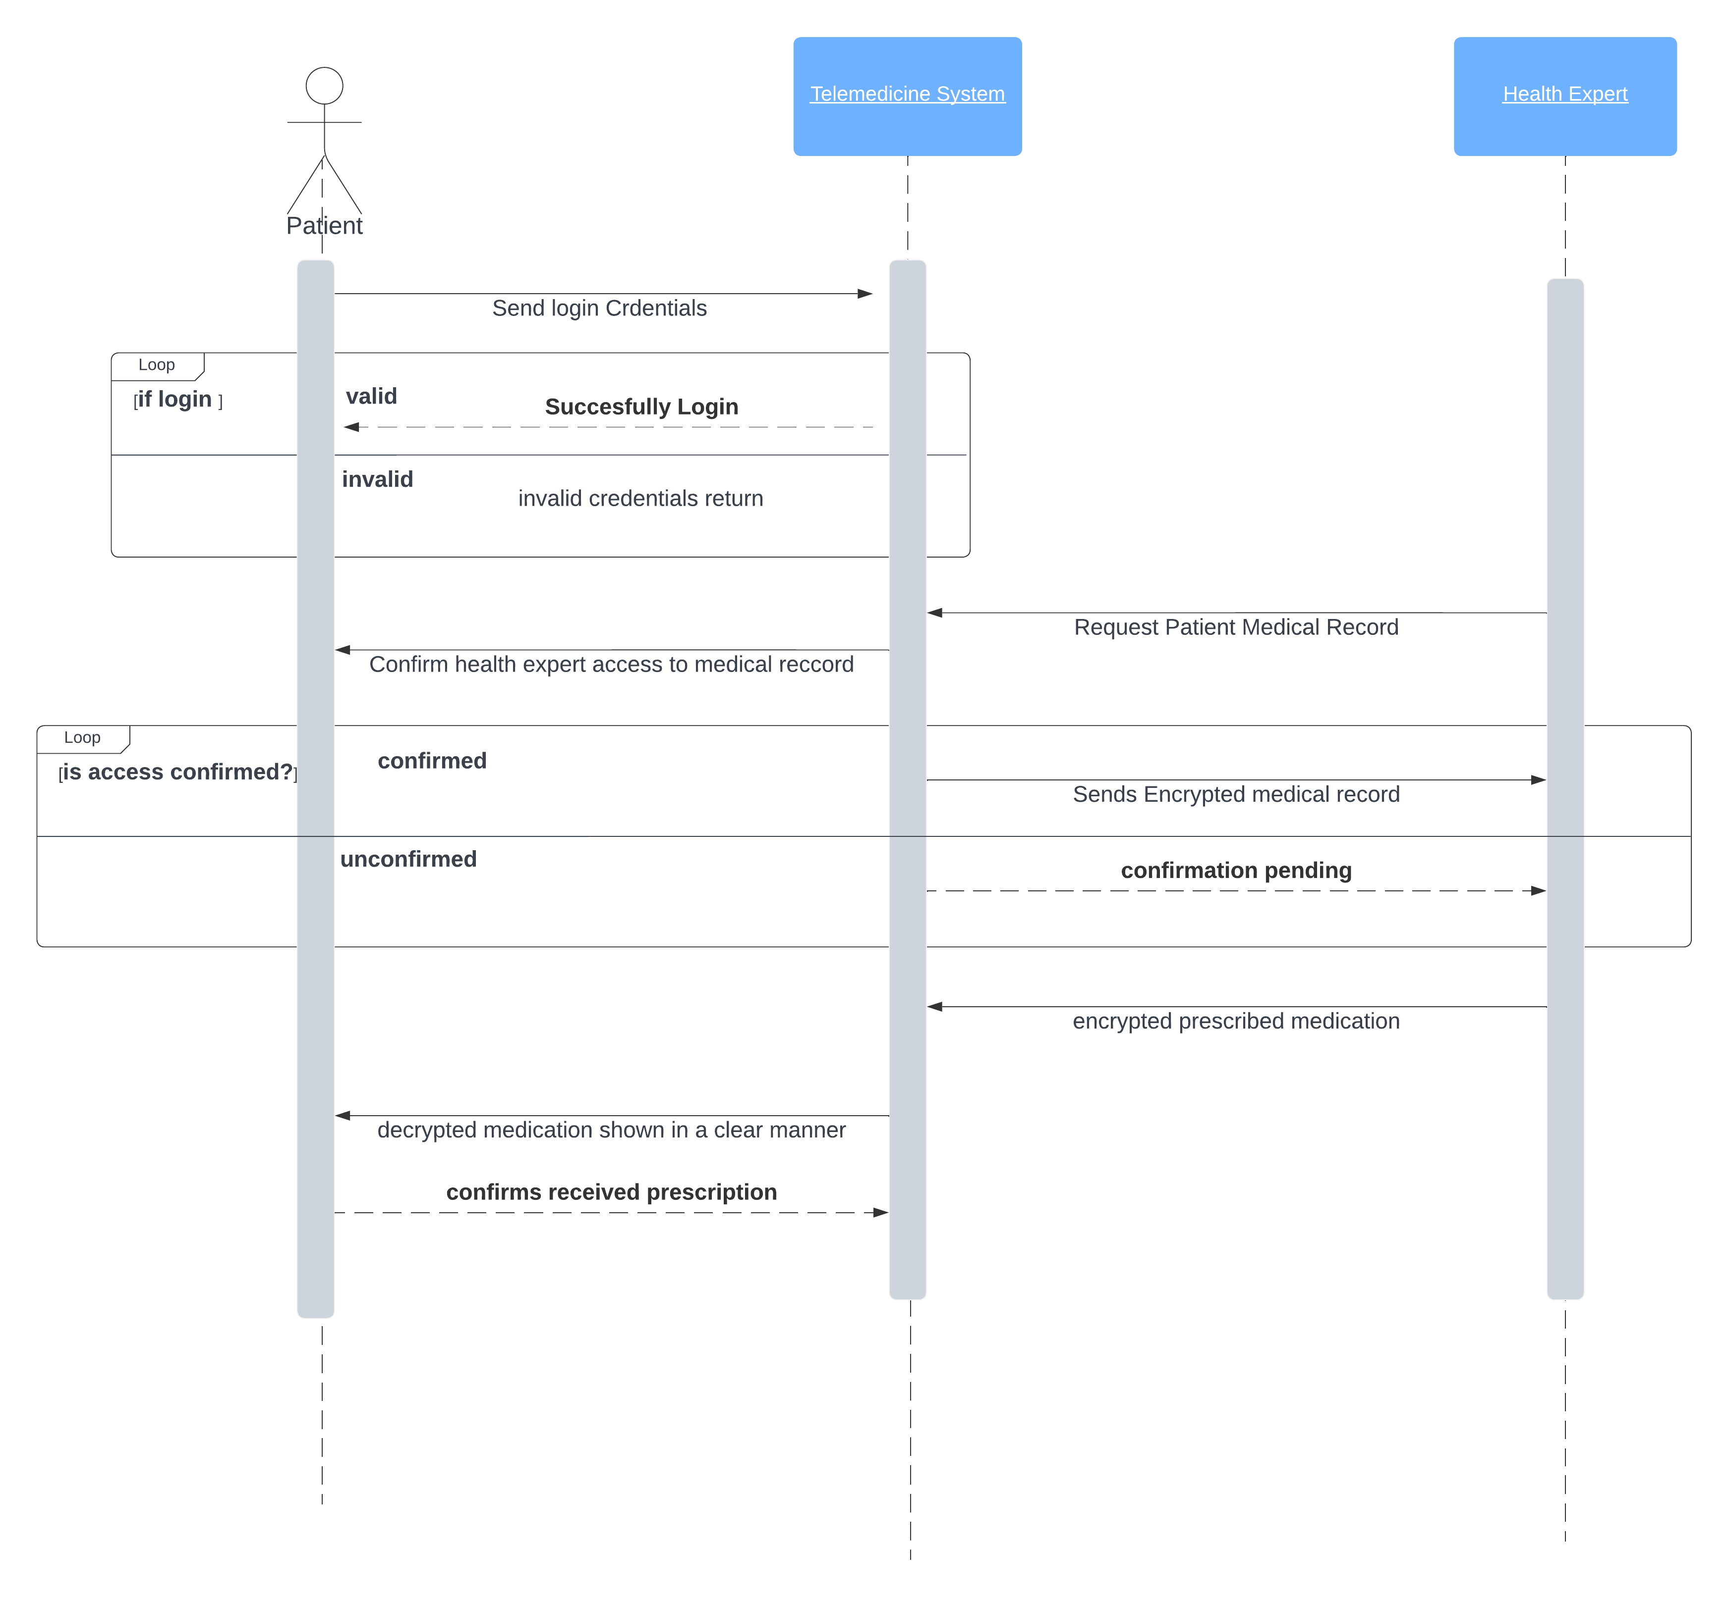
SEQUENCE DIAGRAMS FOR LOGIN,APPOINTMENTS AND ISSUING PRESCRIPTIONS

Slide 17
2) UI DESIGN
A) ADMIN PANEL

Slide 18
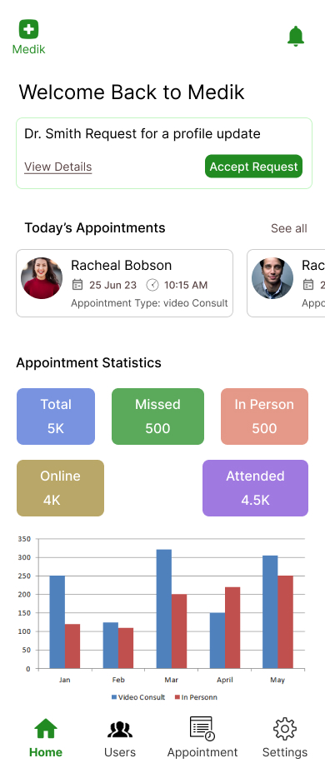
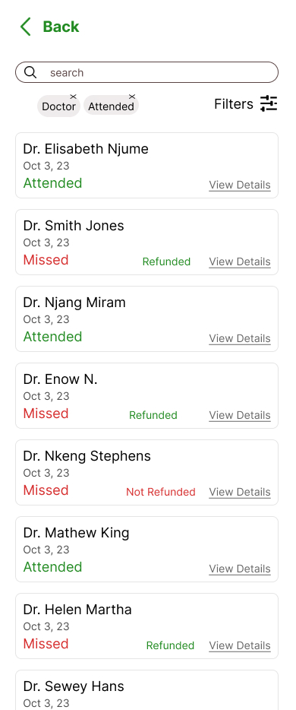

Slide 19
UI DESIGN
B) Patient Panel

Slide 20
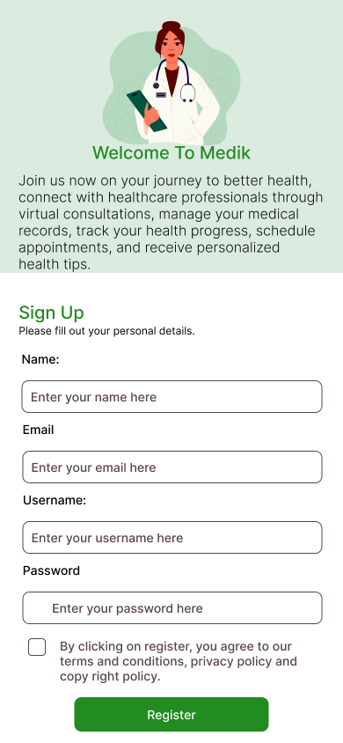
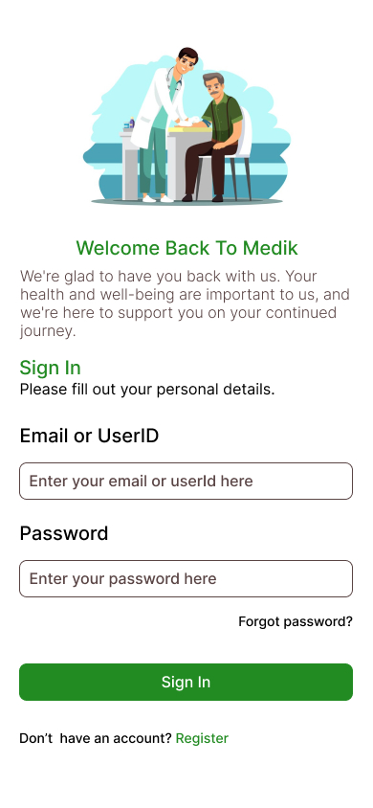
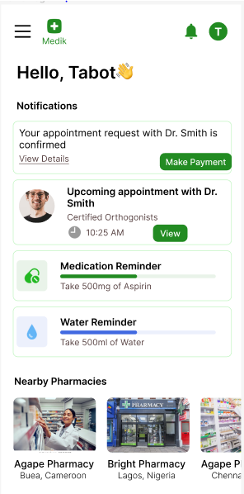

Slide 21
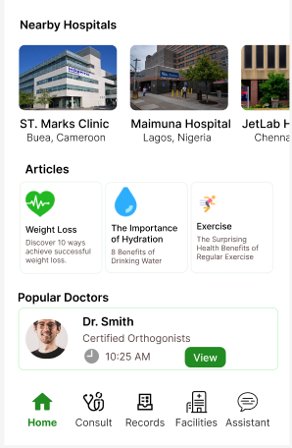
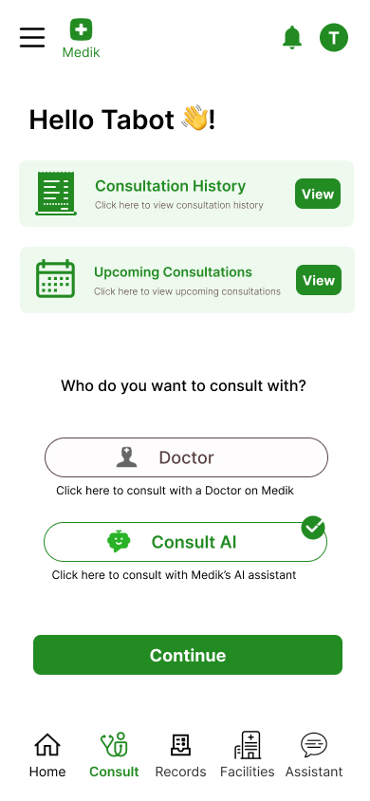
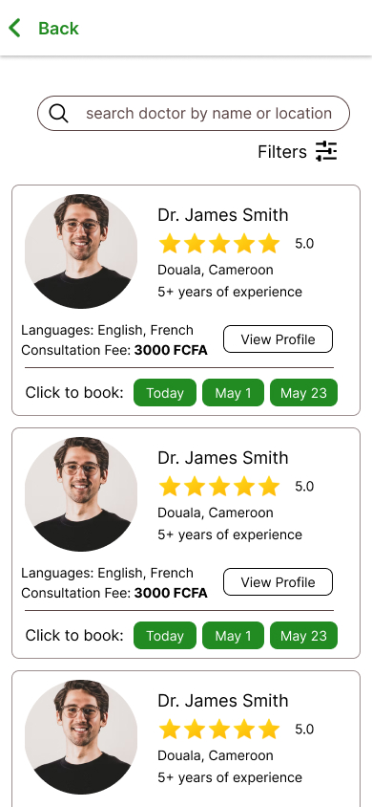

Slide 22
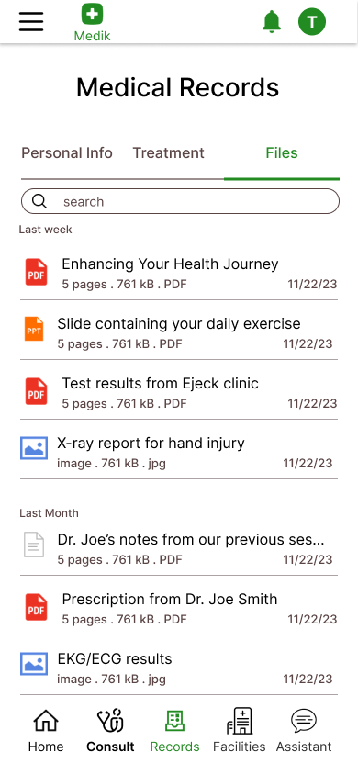
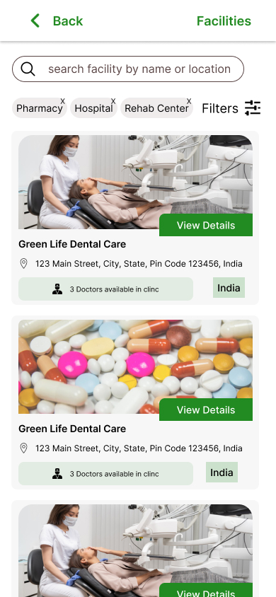
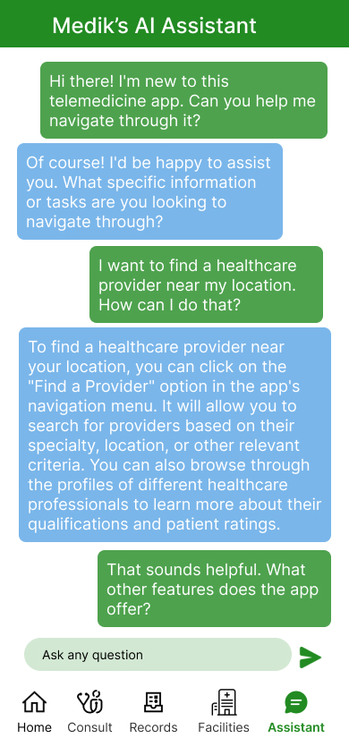

Slide 23
UI DESIGN
C) DOCTOR PANEL

Slide 24
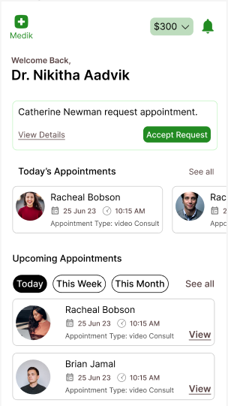
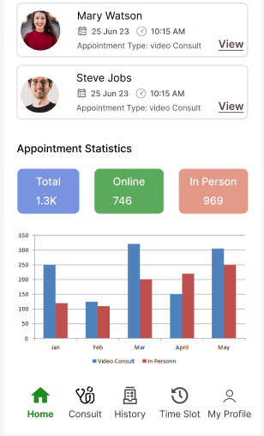
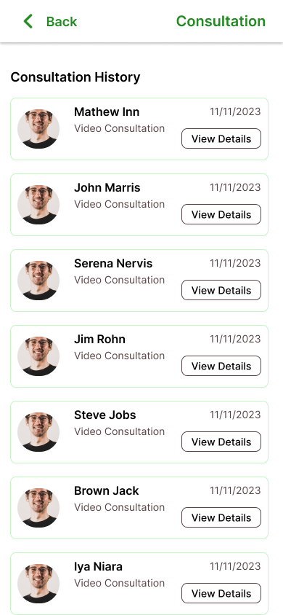

Slide 25
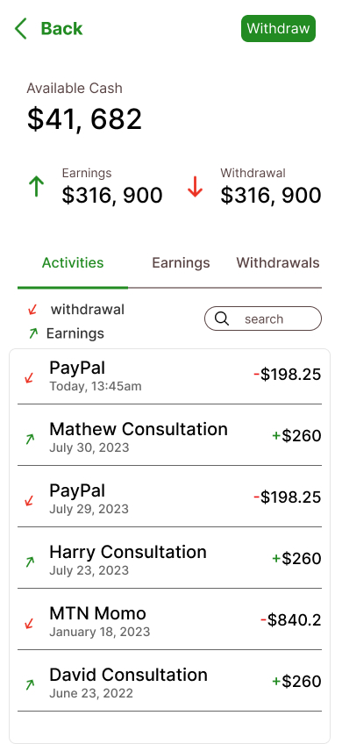
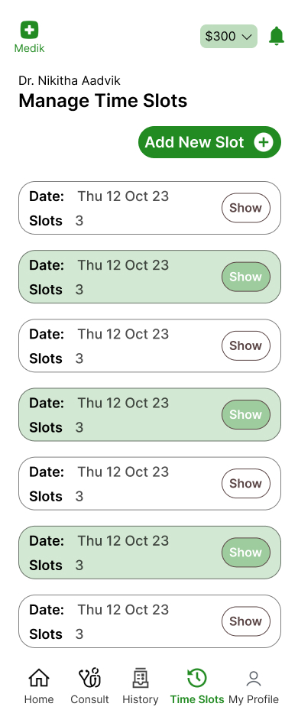
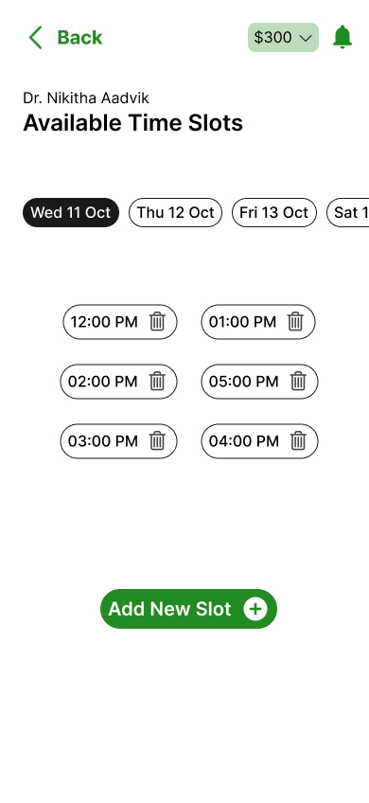

Slide 26
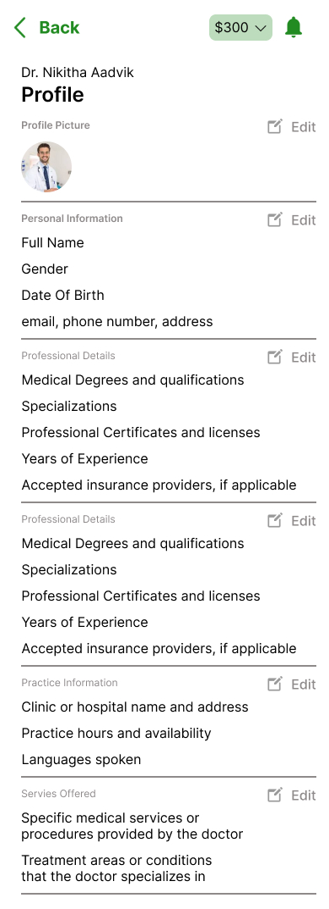
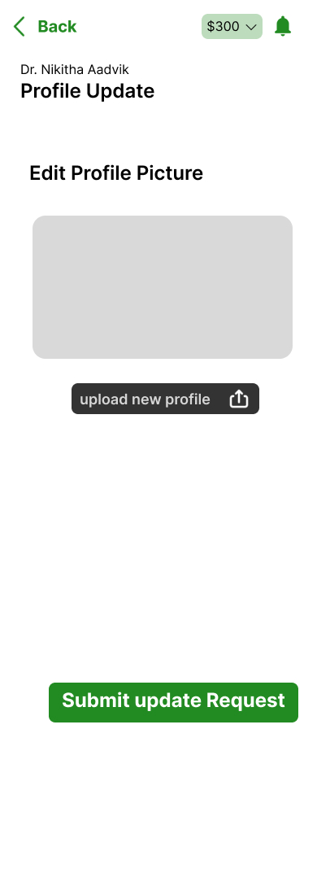

Slide 27
3) DATABASE DESIGN

Slide 28
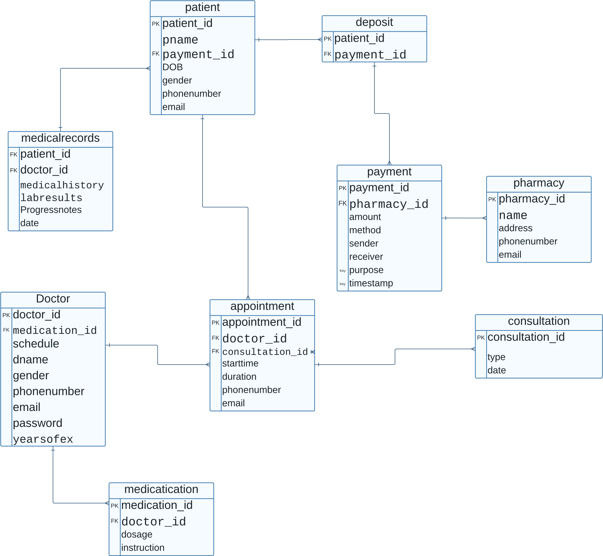

Slide 29
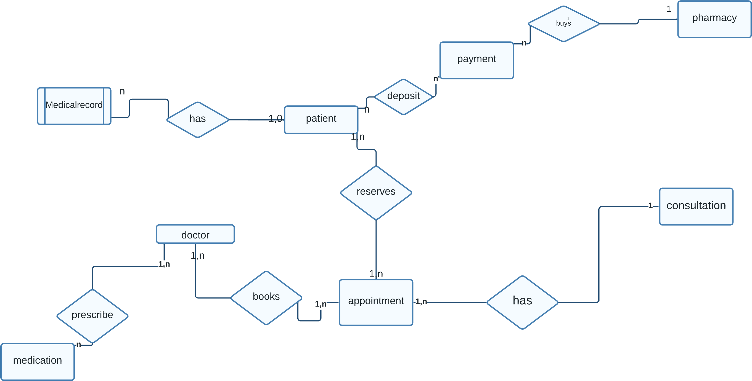

Slide 30
SOME REFERENCES
Morgan, L. A. (2022). HIPAA: A Practical Guide for Covered Entities and Business Associates.
2. Woodcock, J. (2018). ISO 13485:2016 Quality Management Systems - Medical Devices - Application of ISO 9001:2015 for Regulatory Purposes.
3.International Electrotechnical Commission. (2005). IEC 60601-1:2005 Medical electrical equipment - General requirements for safety
4.ITSourceCode. (n.d.). Telemedicine Online Platform Database Design. Retrieved from https://itsourcecode.com/free-projects/database-design-projects/telemedicine-online-platform-database-design/#google_vignette
5. Wikipedia. (n.d.). ISO/IEC 15288. Retrieved from https://en.wikipedia.org/wiki/ISO/IEC_15288

